Slide 1
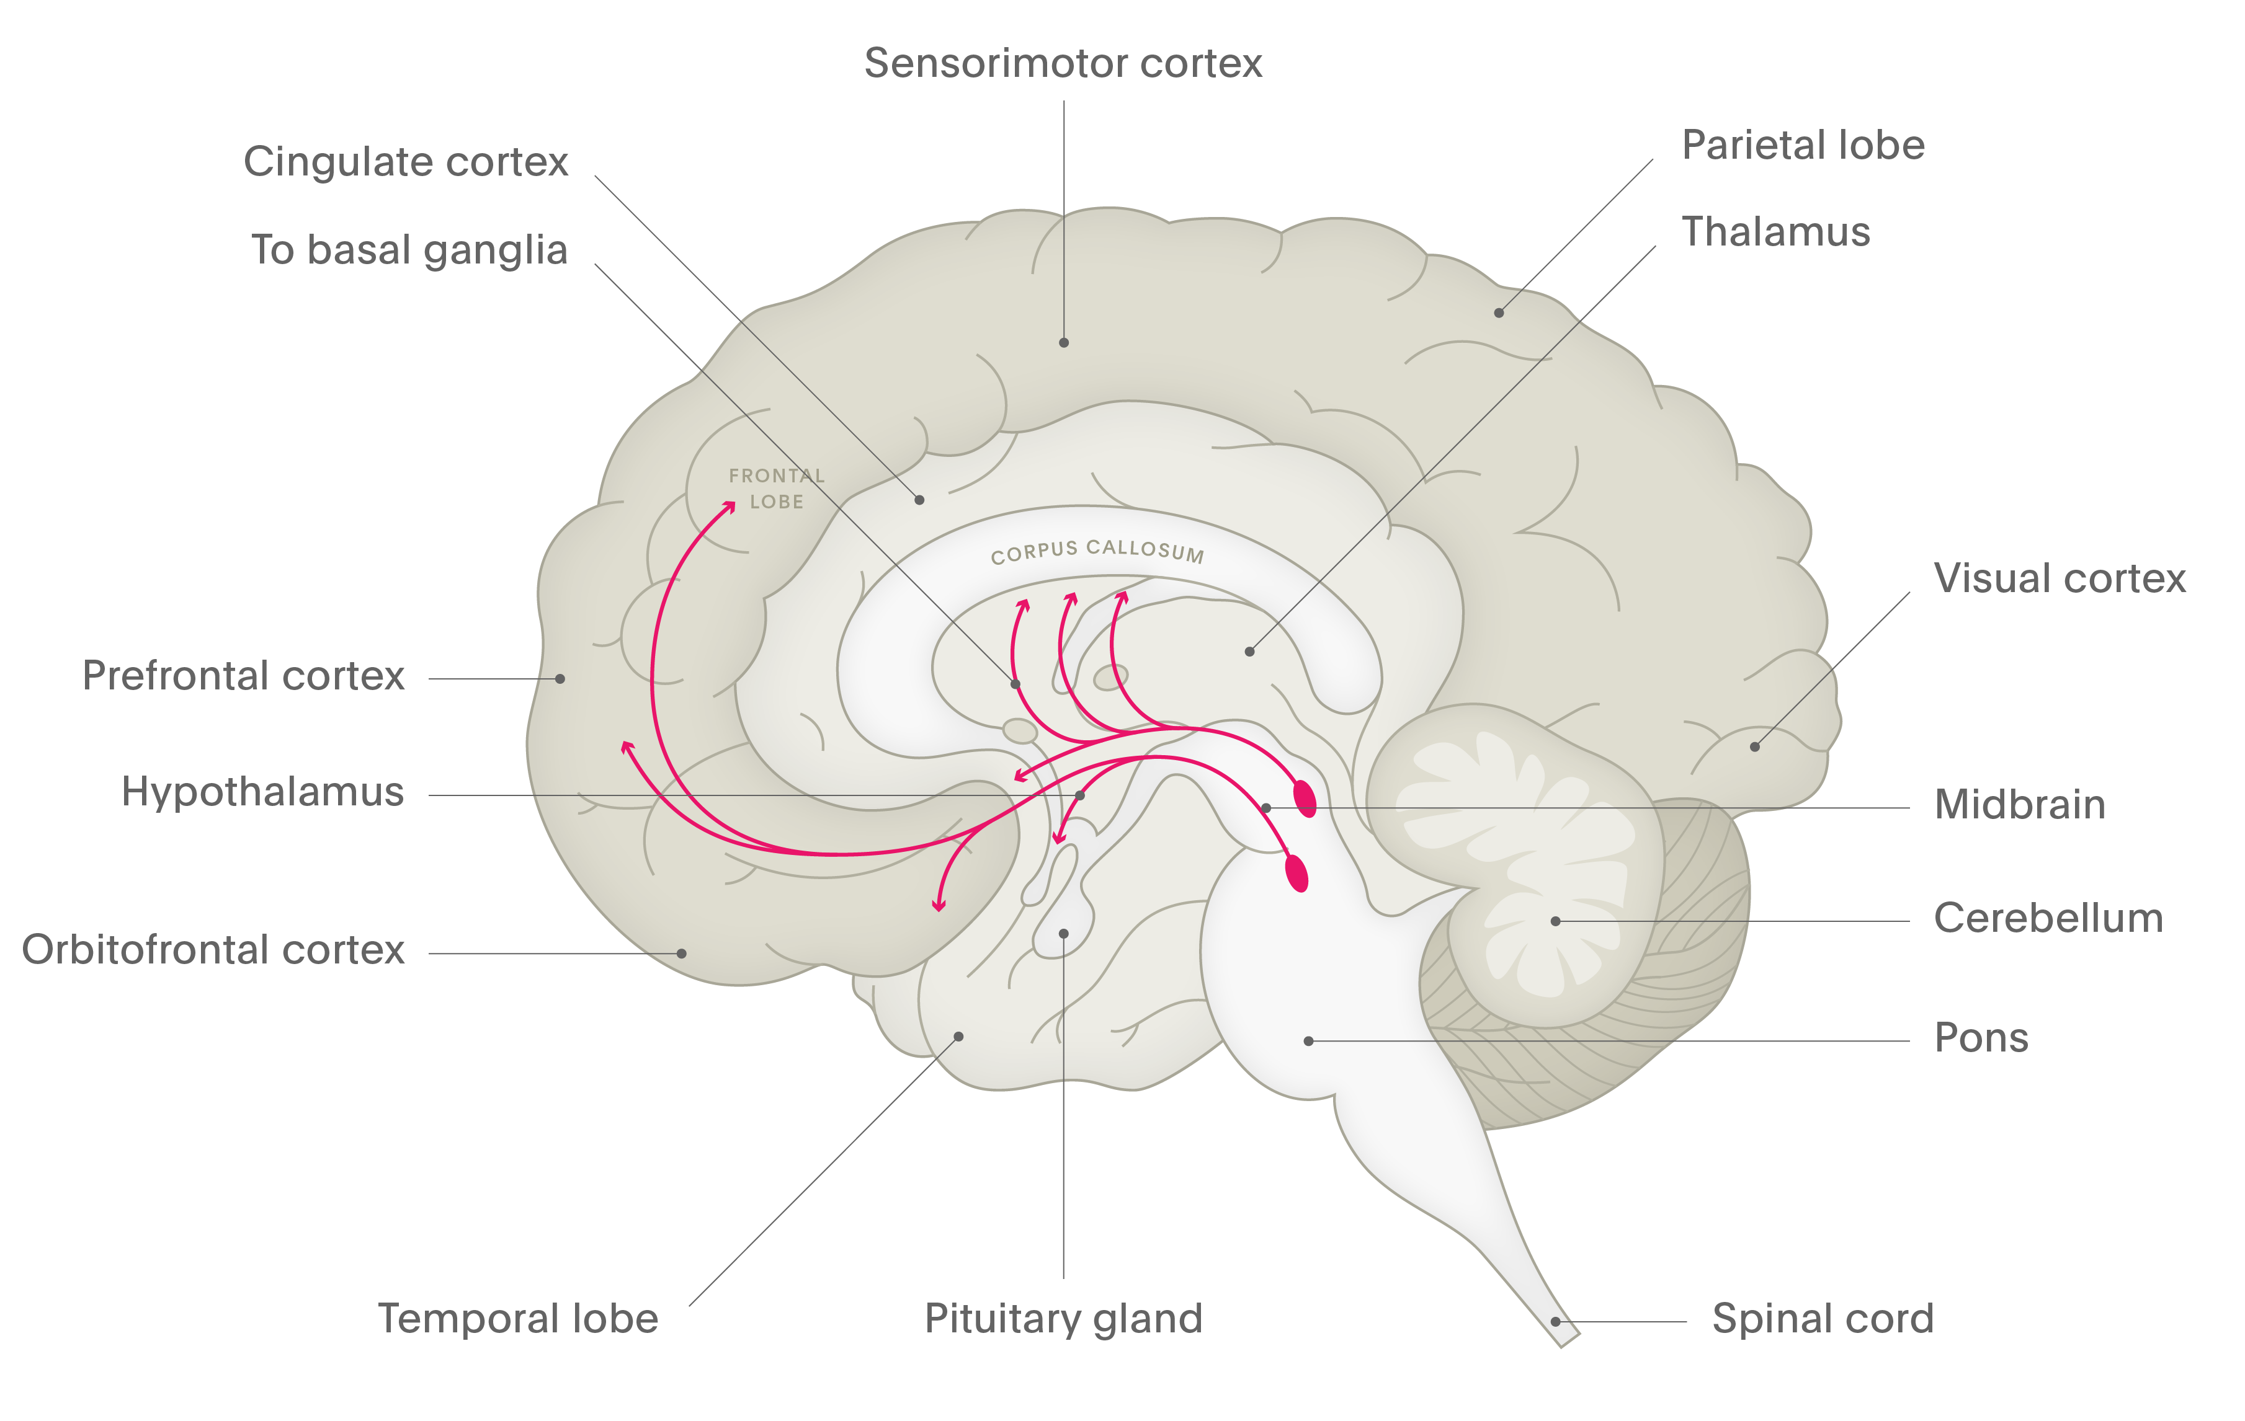
Dopamine
HO
NH₂
Schizophrenia
HO
Dopamine is produced from the precursor molecule DOPA (dihydroxyphenylalanine) by DOPA decarboxylase¹
Dopamine is removed from the synapse by specialised dopamine transporters, and is catabolised by monoamine oxidase (MAO) and catechol-O-methyltransferase (COMT)¹
Dopamine is involved in movement control, motivation, reward, and reinforcement; many addictive substances work by affecting dopaminergic neurones¹⁻³
Nigrostriatal pathway
Dopamine has influence over control of fine movements and initiation of movement^{2,3}
Mesocortical pathway
Here, dopamine influences perception, cognition, and social behaviour^{2,3}
Tuberoinfundibular pathway
Dopamine normally inhibits the release of prolactin³
Mesolimbic pathway
Dopamine is thought to be involved in emotion and memory, pleasurable sensations and reward, the euphoric effects of addictive substances, as well as psychotic symptoms, such as delusions and hallucinations^{2,3}
1. Purves et al. Neuroscience. 4th edition. 2008; 2. Kandel et al. Principles of Neural Science. 4th edition. 2000;
3. Stahl. Essential Psychopharmacology. 2013
Notes:
Dopamine is believed to be involved in motivation, reward, and reinforcement.^{[Purves et al., 2008]} Dopamine also plays an essential role in the control and coordination of movement.^{[Purves et al., 2008]}
Dopamine receptors all influence the activity of the second messenger, cyclic AMP, which is involved in many biochemical processes within a neurone.^{[Kandel et al., 2000]} Dopamine receptor subtypes D₁ and D₅ increase the levels of cyclic AMP, whereas D₂, D₃, and D₄ subtypes decrease the levels of cyclic AMP.^{[Kandel et al., 2000]} Thus, depending on which receptor subtype the neurotransmitter binds with on the postsynaptic neurone, dopamine can increase or decrease cellular activity.^{[Kandel et al., 2000]}
Dopamine, and its actions within the CNS, is critical to the underlying disease state of many conditions, including Parkinson’s disease, which is characterised by a dearth of dopamine, and schizophrenia, which appears to be caused by an overactivity of dopamine within certain brain regions.^{[Stahl, 2013]} Furthermore, many addictive substances work by altering the effect of dopamine within the brain.^{[Purves et al., 2008]} For instance, the drug cocaine appears to act by inhibiting the reuptake of dopamine, which leads to an increased concentration of dopamine in the synapse, prolonging its action.^{[Purves et al., 2008]}
Delusion – a disturbance in thought leading to false beliefs.
Hallucination – a false sensory perception, such as hearing voices or seeing things that are not there.
Prolactin – a hormone, produced and released into the bloodstream by the pituitary gland, that is involved in the secretion of milk and breast growth; unusually high amounts are responsible for impotence and loss of libido in both men and women.
References:
Kandel ER, Schwartz JH, Jessell TM (eds). Principles of Neural Science. 4th edition. McGraw-Hill, 2000.
Purves D, Augustine GJ, Fitzpatrick D, et al. (eds). Neuroscience. 4th edition. Sinauer Associates, 2008.
Stahl SM. Stahl’s Essential Psychopharmacology. Neuroscientific Basis and Practical Applications. 4th edition. © Cambridge University Press, 2013.

